Slide 1

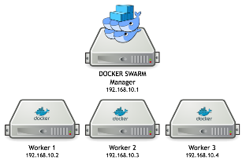


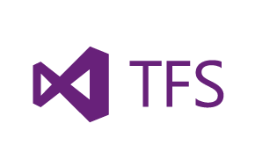


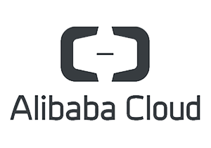

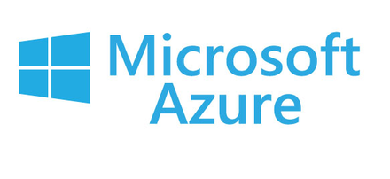



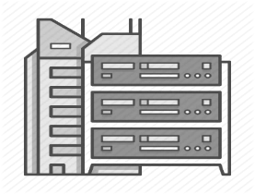
Click2Cloud Shift’M Tool
Overview:
Repository
Kubernetes Cluster
Click2Cloud Shift’M is a tool that makes it easy to containerize your source code and push created docker image into your registry.
User can containerize the web app/api, by providing just the git source repo, and using Click2Cloud builder images for Python, Perl, Ruby, NodeJs, .NET Core 2.0, .NET Legacy and much more.
Kubernetes Dashboard
Cloud Service provider
Shift’M
Repository
Local Docker Infrastructure
High Level Features:
Contact Us
User can manage kubernetes cluster by using kubernetes dashboard and also containerize his application source code by using Click2Cloud Shift’M tool.
Push application source code docker image into docker registry for future use.
The main advantage of using Click2Cloud Shift’M tool for building docker images of the source code is the ease of use for developers.
As a builder image author, you must understand two basic concepts in order to provide the best possible performance: The build process and Shift’M script.
Click2Cloud Inc.
1000 124th Ave NE
Bellevue, WA 98005, USA
+1 (425) 748 9666
pm@click2cloud.net
Visit us on the web:
www.click2cloud.net

